Slide 1
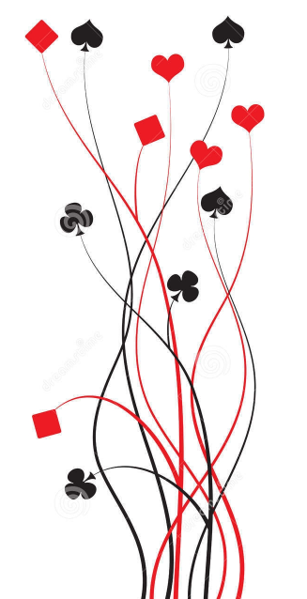

Bridge First Steps
Primer
Lesson 7: Are You Game?
Ian and Julie Grant

Slide 2

Are you game?
When we are playing in NT we have used 25 hcp as the benchmark for trying for game. Unfortunately this same value does not work for suit contracts.
In No Trumps we need to take just 9 tricks to make game. In a Major suit (Hearts or Spades) we need 10 tricks and in a Minor (Clubs or Diamonds) 11 tricks.
The more tricks we need in theory the more points are required.
Going on points alone we would need 26-27 hcp for a major suit game and 28-29 hcp for a minor suit game.
But this is not the true story – points are only a guide when you are in a suit contract.

Slide 3
Evaluating Hand Strength in a Suit Contract
 | ♠ | J9642
 | ♥ | A84
 | ♦ | AQ3
 | ♣ | 74
 | N.
 | W | E.
 | S.
 | ♠ | QT873
 | ♥ | 76
 | ♦ | K5
 | ♣ | AK82
Consider this hand from a previous lesson; N/S have a combined 23 count but can make 11 tricks in a spade contract with careful play.
We could simply examine the two hands and try to work out how many tricks we are likely to take.
On this hand its not that hard to see that we should make at least 10 tricks
(3 spades, ♥A, ♦AKQ, ♣AK and a club ruff).
However, to see this can be very difficult; and, when we play full Bridge, we cannot see both hands!
We need a better tool for evaluating our trick taking potential in a suit contract.

Slide 4

A new tool
Some clever person worked out that counting ‘losers’ is a much better method than trying to count ‘winners’.
They called this method The Losing Trick Count and it is very effective when you have an 8 (or more) card fit and are going to play in a suit contract.
What is a ‘loser’
Simply put, it is any card other than an A,K or Q.
However, if it were that easy then our HCP method would work too.
If we are playing in a suit contract it is very unlikely that the fourth (and subsequent) cards in a suit will be a loser. The fourth card will have been established as a winner, it is a trump or we can ruff it in the other hand.
So we limit ourselves to a maximum of 3 losers in any one suit; a maximum of 12 losers in a hand.

Slide 5

Losing Trick Count
It wouldn’t make much sense to count more losers in a suit than we have cards in that suit; so, for example, a 2-card suit can have a maximum of 2 losers.
We have already seen that we ignore the fourth and subsequent cards in a long suit.
This is the crux of the LTC method; it not only takes account of our high cards but it also adjusts for the shape of our hand.
How do we count losers?
We do it suit by suit.
If we have only one card in a suit, it must be a loser unless its the Ace.
If we have two cards in a suit then they are losers unless they are the Ace or King.
If we have three or more cards in a suit then they are losers unless they are the Ace, King or Queen.
We then add the count for each suit together to get our total loser count for the hand.

Slide 6
Counting Losers: an example
 | ♠ | J9642
 | ♥ | A84
 | ♦ | AQ3
 | ♣ | 74
 | N.
 | W | E.
 | S.
 | ♠ | QT873
 | ♥ | 76
 | ♦ | K5
 | ♣ | AK82
 | Looking at the North hand
 | ♠ | 3 losers | Can’t have more than 3 | Total: 8 losers | Total: 8 losers
 | ♥ | 2 losers | Not the A
 | ♦ | 1 loser | Not the A or Q
 | ♣ | 2 losers | Only 2 cards
 | Looking at the South hand
 | ♠ | 2 losers | Not the Q | Total: 6 losers | Total: 6 losers
 | ♥ | 2 losers | Only 2 cards
 | ♦ | 1 loser | Only 2 cards, not the K
 | ♣ | 1 loser | Not the A or K

Slide 7

Part 1: Spot the

Slide 8

Counting Losers: what use is it?
 | ♠ | J9642
 | ♥ | A84
 | ♦ | AQ3
 | ♣ | 74
 | N.
 | W | E.
 | S.
 | ♠ | QT873
 | ♥ | 76
 | ♦ | K5
 | ♣ | AK82
We can have up to 12 losers and so can our partner; so that’s a maximum of 24 between us.
On this hand North has 8 losers and south has 6; so that’s just 14 between them.
If we subtract the 14 from the maximum 24 we are left with 10, 10 what?
If they are not losers, they must be:
Winners!
So despite only holding 23 high card points, the Losing Trick Count method predicts that we can make 10 tricks on this hand which is enough for game in spades.

Slide 9
Part 2: Are You Game?

Slide 10
Summary
How many tricks can I make?
Count your losers in each suit and add them together.
Add your loser count to partner’s and subtract from 24.
A note of caution
Losing Trick Count (LTC) is a guide only; it is not guaranteed to be accurate.
The more tricks LTC predicts the less accurate it tends to be, so be careful with minor suit contracts.
No method is a substitute for common sense!
(e.g. LTC could predict 11 tricks with clubs as trumps but you can see that you are missing the AK of trumps and another A….)

Slide 11
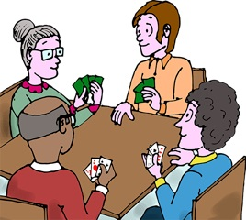
Let’s play some hands

