Slide 1
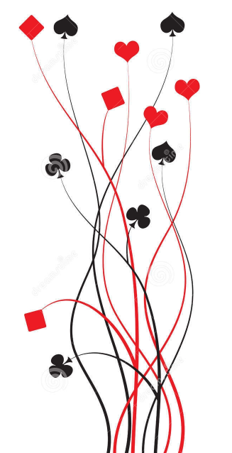

Bridge First Steps
Primer
Lesson 5: Suit You Sir
Ian and Julie Grant

Slide 2
A hand for No Trumps?
We have 9 top tricks; BUT the defenders are going to take lots of diamond tricks FIRST. Bridge would be a silly game if we had to play this hand in No Trumps.
 |  |  | ♠ | AQ86
 |  |  | ♥ | A9
 |  |  | ♦ | 742
 |  |  | ♣ | AKQ
 | ♠ |  | N. |  | ♠
 | ♥ |  | W | E. | ♥
 | ♦ |  |  |  | ♦
 | ♣ |  | S. |  | ♣
 |  |  | ♠ | KJ75
 |  |  | ♥ | T832
 |  |  | ♦ | Q
 |  |  | ♣ | J9873
Dummy
This is why we have suit contracts
A suit contract is one where declarer nominates one of the four suits as trumps.
Trumps are a suit with super-powers; whenever you can’t follow suit you can play a trump instead and WIN the trick.
If more than one trump is played to a trick then the highest trump wins as you might expect.
Playing a trump on a trick is often called ‘ruffing’ or ‘trumping’.

Slide 3
What’s so great about trumps?
 |  |  | ♠ | AQ862
 |  |  | ♥ | 72
 |  |  | ♦ | 873
 |  |  | ♣ | J98
 | ♠ |  | N. |  | ♠
 | ♥ |  | W | E. | ♥
 | ♦ |  |  |  | ♦
 | ♣ |  | S. |  | ♣
 |  |  | ♠ | KJ7
 |  |  | ♥ | AK543
 |  |  | ♦ | Q
 |  |  | ♣ | AKQ4
Dummy
Trumps give us control of the hand:
On this hand we are playing with spades as trumps, so the defender’s can only take one diamond trick before we win with a trump.
Trumps help us make extra tricks:
If we were playing in a NT contract we can make at most 5 tricks with our spades (less if we have to discard some on the defender’s diamonds).
However, if we play with spades as trumps we can make 5 spade tricks in dummy and two more by ruffing diamonds using the spades in declarer’s hand as trumps.
(Note that you usually only make extra tricks if you ruff in the hand that has the shorter trumps).

Slide 4
Scoring for trump contracts
NT
In NT we require 9 tricks to make the 100 points needed for a game bonus.(40 + 30 + 30)
In Clubs or Diamonds we only score 20 points per trick, so we need to make 11 tricks to make game (5 x 20 = 100).
If you have an eight (or more) card fit in a minor then it is usually better to play in No Trumps unless you have an obvious weakness. You will need to take at least 2 more tricks in a minor suit contract to outscore No Trumps (assuming you can make the contract).
♣♦
In Hearts or Spades we score 30 points per trick (over 6), so we need to make 10 tricks to make game (4 x 30 = 120). However; suit contracts will often make one more trick than a NT contract on the same hand because you can trump the defender’s winners.
Making 10 tricks in a major suit scores 420, which is more than making 9 tricks in NT; so if you have an eight (or more) card fit in a major then it is usually better to play with that suit as trumps.
♥♠

Slide 5
A hand for a suit contract
 |  |  | ♠ | AQ86
 |  |  | ♥ | A9
 |  |  | ♦ | 74
 |  |  | ♣ | Q8543
 | ♠ |  | N. |  | ♠
 | ♥ |  | W | E. | ♥
 | ♦ |  |  |  | ♦
 | ♣ |  | S. |  | ♣
 |  |  | ♠ | KJ75
 |  |  | ♥ | T832
 |  |  | ♦ | Q
 |  |  | ♣ | AKJ2
Which suit do I pick?
Dummy
The obvious choice is the suit where we have the most cards between the two hands. Trump cards are powerful so the more we have (and so the less the defenders have) the more tricks we can win.
However:
Major suit contracts (♥ & ♠) score much better than minor suit contracts (♣ & ♦); so on this hand we would choose spades as trumps rather than clubs even though we have more clubs.
The scoring table
NT: 40 + 30 +…
H & S: 30 + 30 + …
C & D: 20 + 20 + …

Slide 6
Managing the trump suit
 |  |  | ♠ | AQ862
 |  |  | ♥ | 72
 |  |  | ♦ | 873
 |  |  | ♣ | J98
 | ♠ |  | N. |  | ♠
 | ♥ |  | W | E. | ♥
 | ♦ |  |  |  | ♦
 | ♣ |  | S. |  | ♣
 |  |  | ♠ | KJ7
 |  |  | ♥ | AK543
 |  |  | ♦ | Q
 |  |  | ♣ | AKQ4
Dummy
It is often a good idea to play a few rounds of trumps early in the play of the hand to take the defender’s trumps away. This is called “drawing trumps”. If you don’t they may ruff one of your winners.
You play the trump suit just the same as any other; taking finesses or flushing out high cards.
Remember to keep track of how many trumps have been played so that you only play as many rounds of trumps as necessary; otherwise you might run out later!
Draw trumps when you are worried that the defenders might ruff your winners in other suits.

Slide 7
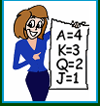
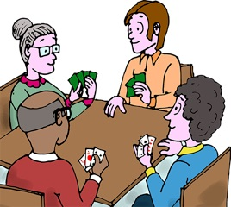
Let’s play some hands
Remember: The scoring table
NT: 40 + 30 +…
H & S: 30 + 30 + …
C & D: 20 + 20 + …
100 points or more for game

