Slide 1
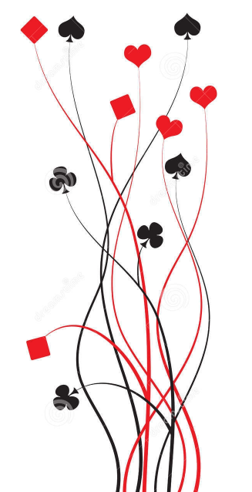
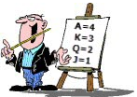
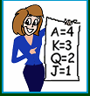
Bridge First Steps Primer Lesson 4: How did you do?
Ian and Julie Grant

Slide 2

What have we learnt so far?
Bridge is a trick taking game; the more tricks you take the better you do.
Playing the Hands We have played a number of hands with no trumps.
We have learnt that not only do we win tricks with top honour cards but we can also take tricks with small cards when we have a long suit to run.
So when we are declarer, to ensure we make those small cards too, we need to assess the hand to see how we can play to make the most tricks.
Setting our Target
But what we haven’t covered yet is that we should declare up front how many tricks we are aiming to take.

Slide 3

What is a contract?
A contract is an undertaking to make a number of tricks greater than six.
A game contract is one which scores 100 points or more and this attracts a bonus; so making game (if you can) is very important.
In MiniBridge you can choose to play in a part-score or game contract.
However, you can only gain the game bonus if you declare that you are trying for game at the start of the hand.
How do I choose?
The simple rule for MiniBridge and no trump contracts is that you try for game with a combined High Card Points (HCP) total of 25 or more.

Slide 4
What happens if we make our contract?
In no trumps we score 40 points for the first trick over six we make and 30 points for each subsequent trick.
Making 9 tricks in a part-score contract in No Trumps scores:
40 + 30 + 30 + 50 = 150
If we are playing in a part-score contract and make, we score a bonus of 50 points.
Making 9 tricks in a game contract in No Trumps scores:
40 + 30 + 30 + 300 = 400
If we make a game contract then we score a bonus of 300 points.
What happens if we don’t?
But making only 8 tricks in a game contract in No Trumps, the defenders score 50 points.
The defenders score 50 points for each trick we are short of our target.
In a part-score contract our target is 7 tricks or more.
In No Trumps the 7th trick scores 40 points, extra tricks score 30 points each. 9 tricks are needed for game.
In a no trump game contract our target is 9 tricks or more.

Slide 5
Choose your contract
The next hands we play, declarer should state whether they are trying for game or not.
At the end of the hand, work out the score for either the declaring side or the defenders.
If declarer makes the contract: Score 40 points for the seventh trick and 30 for each subsequent one. Add on a part-score bonus of 50 or a game bonus of 300.
Remember
Only one side scores points on any given hand.
Declaring side scores if they make their contract;
Defending side scores if declarer fails.
If the defenders prevent declarer from making their contract:
The defenders score 50 points for each trick declarer is short of their target.

Slide 6
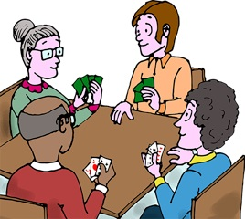
Let’s play some hands

