Slide 1
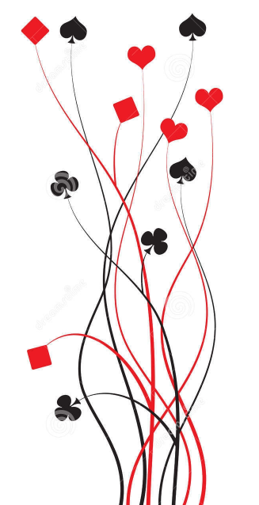
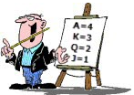
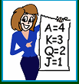
Bridge First Steps
Primer
Lesson 3: Your lead partner
Ian and Julie Grant

Slide 2

Your
partner
The opening lead is one of the most difficult decisions you will have to make.
On a good day you won’t help declarer
On a very good day you might even help the defence!
Defence is much harder than declaring; declarer can see all of their sides cards when trying to plan the play. The opening lead is our chance to get the defence off to a good start; it often makes the difference between getting a good score and getting a bad one.
The good news is that there are some simple, useful rules that can help you; we will look at them today.

Slide 3

The Opening Lead against No Trumps
The opening lead serves two purposes:
To try and win, or at least set up, tricks for the defence
To pass some information to partner about what is in our hand
(note that this isn’t a secret, declarer gets to know too!)
If you lead a card from a good suit this is called an ‘active’ lead, you are trying to set up tricks for the defence.
If you lead a card from a poor suit this is called a ‘passive’ lead, you are hoping not to gift a trick to declarer.
In MiniBridge it is rarely correct to lead from a short suit (less than 3 cards).
Leading from your longest suit is generally the best thing to do as given your holding, the opposition are bound to have less of them

Slide 4
No Trumps - Which card do I lead?
Bridge First Steps
with Ian & Julie Grant
 | You Hold | Standard lead | Examples | Comments
Best | Honour Sequence | Top | QJT53 AKQ7 | By far the safest lead
------------------------------------→ | Near Honour sequence | Top | KQT4 AKJ2
 | Interior Sequence | Top of sequence | KJT3 AQJ72 | Leading the lowest card could risk gifting a trick to the 9.
 | Good suit headed by an honour card | Lowest card | KQ832 AJ54 | (Many people lead 4th highest, we recommend you lead the lowest)
 | Poor suit | Second highest | 97532 732 | Avoid the second example if you can; partner might mistake this for a lead from a good suit
 | Poor suit headed by an honour card | Lowest | Q732
Worst | Doubleton | Top | 73 | Avoid leading a doubleton against NT contracts.

Slide 5
Why does it matter?
If we lead from a good suit we want partner to lead the suit again when they win a trick.
Partner will know that we have a good suit if we lead a high card (top of sequence) or a low card.
If we lead from a poor suit we don’t want partner to lead the suit again.
Partner will know we have a poor suit if we lead a middling card.

Slide 6
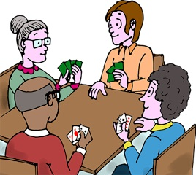
Let’s play some hands

