Slide 1
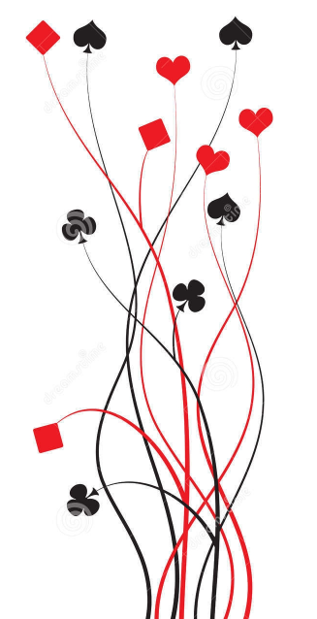
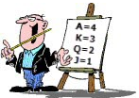
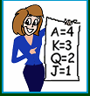
Bridge First Steps Primer Lesson 2: More Tricks
Ian and Julie Grant

Slide 2
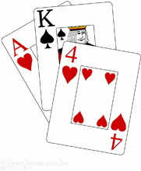
What have we learnt so far?
Play Your Cards Right
Whether you attended the Getting Started lesson or just read the notes we sent out, you should now understand that bridge is a game of taking tricks.
The more tricks your side takes the better you have done.
This trick taking is the same in full bridge as it is in mini-bridge so we are going to use mini-bridge for the next few weeks to explore how we can maximise the number of tricks we take.

Slide 3
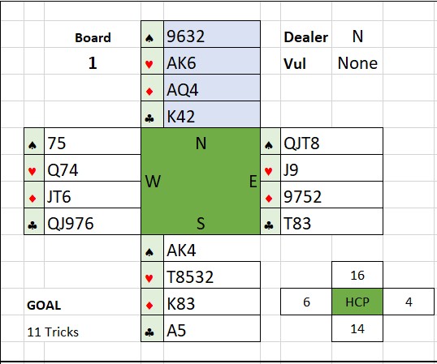
A hand of MiniBridge
How many points does each player have?
Who announces their points first?
Dealer (North)
Which pair are the declaring side?
North/South
Who is declarer?
North
Which player makes the first lead?
East
Which card should they lead?
♠Q
How many tricks is declarer sure to make?
Nine
Can they make any more?
Two more hearts

Slide 4
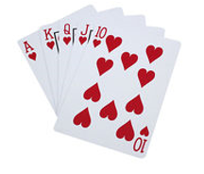
Developing long suits
When you have a lot of cards in one suit between the two hands you can make extra tricks by playing that suit. Even if you have to lose tricks in that suit first, the remaining cards will be winners.
You should do this before taking your top tricks in other suits.
This means you can get the lead back when the defenders lead the other suits and it prevents the defenders from making extra tricks in their long suits.

Slide 5

Some Advice for Declarers
Make a plan before playing a card from dummy to the first trick.
Count your winners first.
Work out where you can make extra tricks.
Small cards can be made into winners if you have a long suit.
Remember
It doesn’t matter whether you win the trick in hand or in dummy,
it counts for your side.

Slide 6
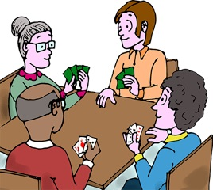
Let’s play some hands

Slide 7
A New Trick
South is declarer in a NT contract. We are just going to look at the heart suit.
We don’t know how the missing cards are split between the defenders.
 |  |  | ♠
 |  |  | ♥ | AQ3
 |  |  | ♦
 |  |  | ♣
 | ♠ |  | N. |  | ♠
 | ♥ | unknown | W. | E. | ♥ | unknown
 | ♦ |  |  |  | ♦
 | ♣ |  | S. |  | ♣
 |  |  | ♠
 |  |  | ♥ | 9742
 |  |  | ♦
 |  |  | ♣
How many tricks can South make in hearts?
Obviously we can make the Ace; and we might make the fourth heart in South’s hand if the defender’s cards are split 3-3.
What about the Queen of Hearts?
We will make the ♥Q if East leads a heart; but they are unlikely to be so helpful.
Is there any other way?

Slide 8
A new trick: the simple finesse
 |  |  | ♠
 |  |  | ♥ | AQ3
 |  |  | ♦
 |  |  | ♣
 | ♠ |  | N. |  | ♠
 | ♥ | unknown | W. | E. | ♥ | unknown
 | ♦ |  |  |  | ♦
 | ♣ |  | S. |  | ♣
 |  |  | ♠
 |  |  | ♥ | 9742
 |  |  | ♦
 |  |  | ♣
What if West has the King of Hearts?
If we lead a low heart from the South hand then West will probably play low (2nd hand), so if we now play the Queen it will win the trick.
If West plays the King instead then we win with the Ace and our Queen is now master.
This play is called a finesse; it simply means playing for a specific card to be in the right place for you.
Of course if East has the ♥K then we would lose the trick; but at least we have given ourselves a 50% chance.

Slide 9
A new trick: more simple finesses
 |  |  | ♠
 |  |  | ♥ | AKJ
 |  |  | ♦
 |  |  | ♣
 | ♠ |  | N. |  | ♠
 | ♥ | unknown | W. | E. | ♥ | unknown
 | ♦ |  |  |  | ♦
 | ♣ |  | S. |  | ♣
 |  |  | ♠
 |  |  | ♥ | 9742
 |  |  | ♦
 |  |  | ♣
 |  |  | ♠
 |  |  | ♥ | K83
 |  |  | ♦
 |  |  | ♣
 | ♠ |  | N. |  | ♠
 | ♥ | unknown | W. | E. | ♥ | unknown
 | ♦ |  |  |  | ♦
 | ♣ |  | S. |  | ♣
 |  |  | ♠
 |  |  | ♥ | 9742
 |  |  | ♦
 |  |  | ♣
We can win three tricks if West has the ♥Q by leading from South and playing the Jack.
We can win one trick if West has the ♥A by leading from South and playing the King.

Slide 10
A new trick: more simple finesses
 |  |  | ♠
 |  |  | ♥ | Q83
 |  |  | ♦
 |  |  | ♣
 | ♠ |  | N. |  | ♠
 | ♥ | unknown | W. | E. | ♥ | unknown
 | ♦ |  |  |  | ♦
 | ♣ |  | S. |  | ♣
 |  |  | ♠
 |  |  | ♥ | A742
 |  |  | ♦
 |  |  | ♣
 |  |  | ♠
 |  |  | ♥ | Q83
 |  |  | ♦
 |  |  | ♣
 | ♠ |  | N. |  | ♠
 | ♥ | unknown | W. | E. | ♥ | unknown
 | ♦ |  |  |  | ♦
 | ♣ |  | S. |  | ♣
 |  |  | ♠
 |  |  | ♥ | A742
 |  |  | ♦
 |  |  | ♣
We can win two tricks if West has the ♥K by leading from South and playing the Queen.
Leading the ♥Q from North doesn’t work, why not?
If West has the King we lose, if East has the King they play it and we just win the Ace.

Slide 11
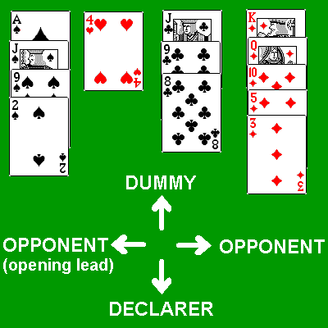
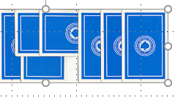
Let’s play some more

