Slide 1
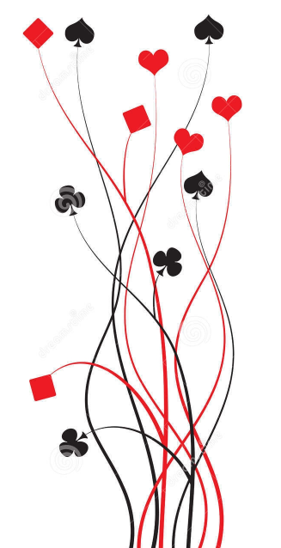
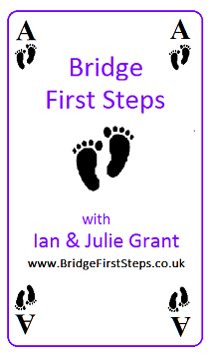
Bridge First Steps Bridge Primer Getting Started
Ian and Julie Grant

Slide 2
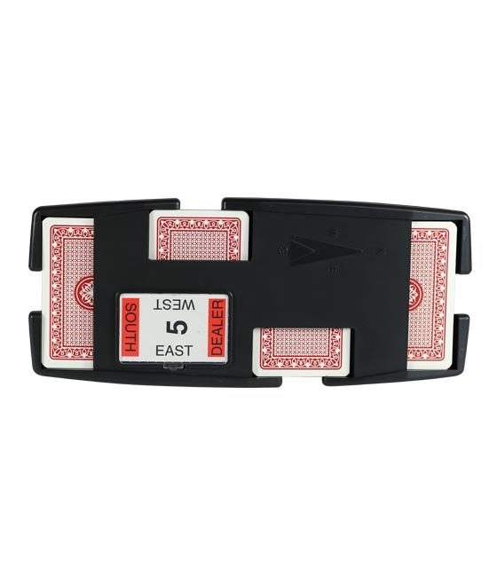
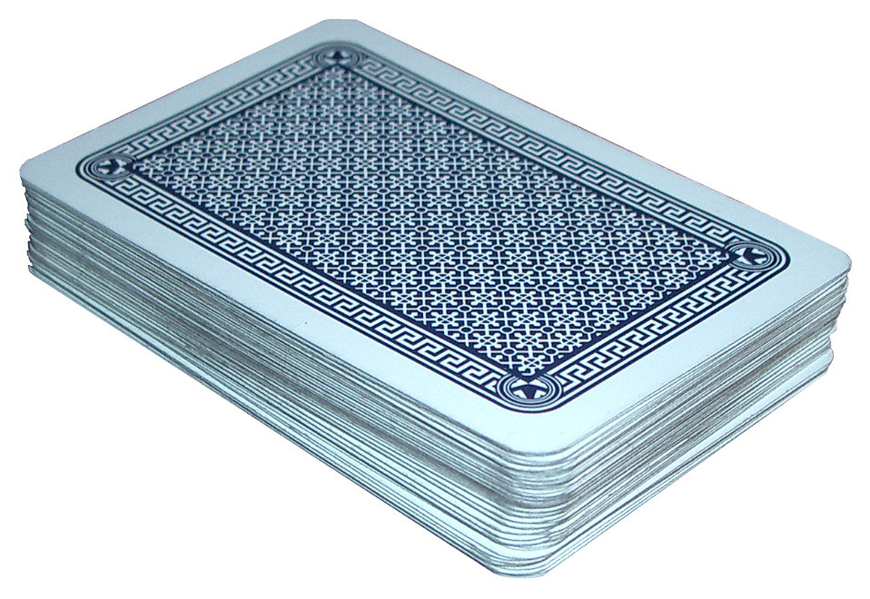
You will rarely see a full pack of cards in a bridge club; usually the hands are pre-dealt and placed into special ‘boards’ like the one shown. After we have played a hand they are returned to the board so that the same hands can be played at another table. This is called ‘duplicate’ Bridge.

Slide 3
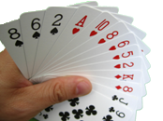
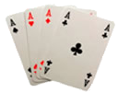
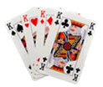
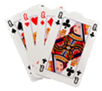
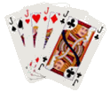
The very first steps
Each time you pick up a Bridge hand (for the rest of your playing career!) it is good practice to do the following:
Count your cards face down and make sure you have 13; if not call one of your teachers and and they will sort it out.
Sort your cards into suits; it may also help to sort them high to low.
Now count your high card points (hcp) as follows:
Ace King Queen Jack
4 points 3 points 2 points 1 point
Note that there are 40 points altogether between the four hands.

Slide 4
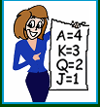
Let’s get some practice How many High Card Points do each of the following hands have?
Hand 1
♠ T 9 7
♥ K Q T 6
♦ K T
♣ A Q J 9
Hand 2
♠ A Q J 4
♥ K Q 8 3
♦
♣ J T 8 6 2
Hand 3
♠ A K 9
♥ A Q
♦ K Q T
♣ A T 9 8 5
0 + 5 + 3 + 7
= 15
7 + 5 + 0 + 1
= 13
7 + 6 + 5 + 4
= 22
Note that we usually show the ten as “T” in the hand diagrams because it is easier to see than “10”.

Slide 5
Bridge and MiniBridge
A hand of Bridge consists of two parts:
The auction where we bid to see who plays the hand
The card play where we try to win tricks
MiniBridge has a simpler way to see who plays the hand
By using MiniBridge we can get you playing very quickly; and also teach you some useful techniques. The follow up course Begin Bidding will build on what you have learned during the Primer course.
MiniBridge is a fun game in its own right (it is excellent for children).

Slide 6
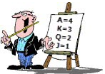
How do we start to play?
Take your cards from the tray and count them FACE DOWN, make sure you have thirteen.
Sort your cards into suits and then count your high card points.
Starting with the dealer, and then going around the table clockwise, each player announces their number of high card points.
The pair with the highest points total are the declaring side, the other two players will be defenders.
The player in the declaring side with the most high card points is declarer, their partner is dummy.

Slide 7
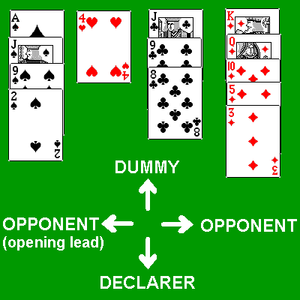
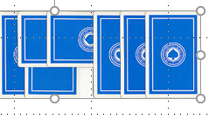
Who goes first?
First, dummy puts their hand face up on the table, sorted into suits.
The person to the left of declarer makes the opening lead.
Play then continues clockwise until everyone has played a card; you have to follow suit if you can. Dummy can’t help with the play, they can only play a card when told to do so by declarer.
When a trick is completed turn your card over in front of you, pointing towards your partner if your side won the trick, pointing the other way if you didn’t. Overlap this card with the card from the previous trick. You should be able to easily see how many tricks your side has won or lost.
The winner of the previous trick leads first to the next one.

Slide 8
What happens at the end of the hand
Declarer counts how many tricks their side has won. For now, all that matters is how many tricks they have taken, we will tell you if you have done well (or not!)
We will tell you how the scoring works in lesson 2.
Scoop up your cards, shuffle them, and place them back into the board face down.
You are now ready for the next hand.

Slide 9
The Opening Lead
The opening lead is often a tricky decision; we will be devoting a whole lesson to it later on.
For now we will give you some simple advice: Lead from the top of a sequence, preferably one headed by an honour.
A sequence is a set of touching cards such as JT9; an honour card is an Ace, King, Queen or Jack.
Examples (lead the card highlighted) AJT9 QJT43 KQJ
If you don’t have such a sequence then lead the lowest card from your best suit.

Slide 10
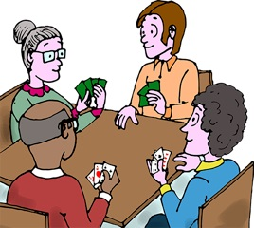
Let’s get started!

